Slide 1
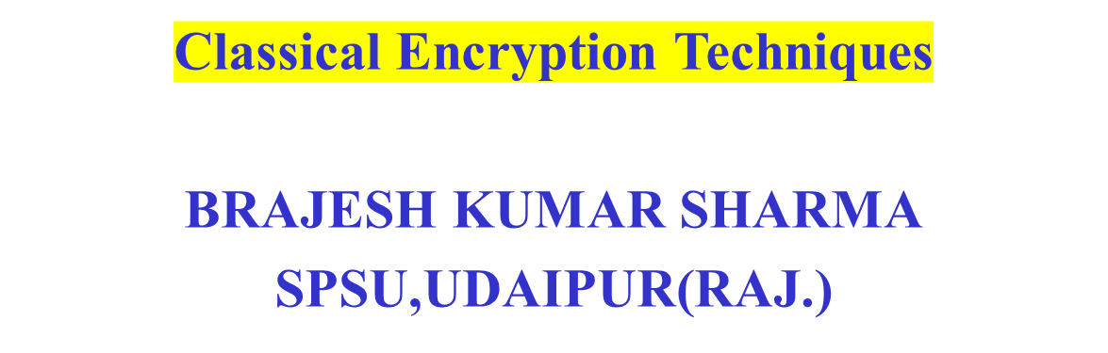
Cryptography and System Security

Slide 2
Secure Communication
Needs and Requirements
Well established needs for secure communication
  War time communication
  Business transactions
Requirements of secure communication
  Secrecy
    Only intended receiver understands the message
  Authentication
    Sender and receiver need to confirm each others identity
  Message Integrity
    Ensure that their communication has not been altered, either maliciously or by accident during transmission

Slide 3
Cryptography
Basics
Cryptography is the science of secret, or hidden writing
It has two main Components:
  Encryption
    Practice of hiding messages so that they can not be read by anyone other than the intended recipient
  Authentication & Integrity
    Ensuring that users of data/resources are the persons they claim to be and that a message has not been surreptitiously altered

Slide 4


Encryption
Cipher
Cipher is a method for encrypting messages
Encryption algorithms are standardized & published
The key which is an input to the algorithm is secret
  Key is a string of numbers or characters
  If same key is used for encryption & decryption the algorithm is called symmetric
  If different keys are used for encryption & decryption the algorithm is called asymmetric
Plain Text
Encryption
Algorithm
Cipher Text
Decryption
Algorithm
Plain Text
Key A
Key B
Notes:
1. Must have done this as an assignment last year.

Slide 5
Encryption
Symmetric Algorithms
Algorithms in which the key for encryption and decryption are the same are Symmetric
  Example: Caesar Cipher
Types:
  Block Ciphers
    Encrypt data one block at a time (typically 64 bits, or 128 bits)
    Used for a single message
  Stream Ciphers
    Encrypt data one bit or one byte at a time
    Used if data is a constant stream of information

Slide 6
Symmetric Encryption
Key Strength
Strength of algorithm is determined by the size of the key
  The longer the key the more difficult it is to crack
Key length is expressed in bits
  Typical key sizes vary between 48 bits and 448 bits
Set of possible keys for a cipher is called key space
  For 40-bit key there are 2⁴⁰ possible keys
  For 128-bit key there are 2¹²⁸ possible keys
  Each additional bit added to the key length doubles the security
To crack the key the hacker has to use brute-force
  (i.e. try all the possible keys till a key that works is found)
  Super Computer can crack a 56-bit key in 24 hours
  It will take 2⁷² times longer to crack a 128-bit key
  (Longer than the age of the universe)
Notes:
1. Must have done this as an assignment last year.

Slide 7
Substitution Ciphers
Caesar Cipher
Caesar Cipher is a method in which each letter in the alphabet is rotated by three letters as shown
A B C D E F G H I J K L M N O P Q R S T U V W X Y Z
D E F G H I J K L M N O P Q R S T U V W X Y Z A B C
Let us try to encrypt the message
  Attack at Dawn
Assignment: Each student will exchange a secret message with his/her closest neighbor about some other person in the class and the neighbor will decipher it.

Slide 8
Substitution Ciphers
Caesar Cipher
Encryption
Plain Text
Message:
Attack at Dawn
Cipher:
Caesar Cipher
Algorithm
Cipher Text
Message:
Dwwdfn Dw Gdyq
Key (3)
Decryption
Cipher Text
Message:
Dwwdfn Dw Gdyq
Cipher:
Caesar Cipher
Algorithm
Plain Text
Message:
Attack at Dawn
Key (3)
How many different keys are possible?
Notes:
The key can be different -

Slide 9
Substitution Cipher
Monoalphabetic Cipher
Any letter can be substituted for any other letter
  Each letter has to have a unique substitute
There are 26! pairing of letters (~10²⁶)
Brute Force approach would be too time consuming
  Statistical Analysis would make it feasible to crack the key
A B C D E F G H I J K L M N O P Q R S T U V W X Y Z
M N B V C X Z A S D F G H J K L P O I U Y T R E W Q
Message:
Bob, I love you.
Alice
Cipher:
Monoalphabetic
Cipher
Encrypted
Message:
Nkn, s gktc wky.
mgsbc
Key
Notes:
Statistical Analysis
Knowing % of occurrences of different letters (e.g. e occurs 13% of time in the document and t occurs 19% of times)
Knowing commonly occurring two and three letter combinations (e.g. in, it, the, ion, ing, …)
If some knowledge about the content is available it is even easier to crack

Slide 10
Substitution Cipher
Polyalphabetic Caesar Cipher
Developed by Blaise de Vigenere
  Also called Vigenere cipher
Uses a sequence of monoalpabetic ciphers in tandem
  e.g. C₁, C₂, C₂, C₁, C₂
Example
Plain Text A B C D E F G H I J K L M N O P Q R S T U V W X Y Z
C1(k=6) F G H I J K L M N O P Q R S T U V W X Y Z A B C D E
C2(k=20) T U V W X Y Z A B C D E F G H I J K L M N O P Q R S
Message:
Bob, I love you.
Alice
Cipher:
Monoalphabetic
Cipher
Encrypted
Message:
Gnu, n etox dhz.
tenvj
Key
Notes:
Statistical Analysis
Knowing % of occurrences of different letters (e.g. e occurs 13% of time in the document and t occurs 19% of times)
Knowing commonly occurring two and three letter combinations (e.g. in, it, the, ion, ing, …)
If some knowledge about the content is available it is even easier to crack

Slide 11
Substitution Cipher
Using a key to shift alphabet
Obtain a key to for the algorithm and then shift the alphabets
  For instance if the key is word we will shift all the letters by four and remove the letters w, o, r, & d from the encryption
We have to ensure that the mapping is one-to-one
  no single letter in plain text can map to two different letters in cipher text
  no single letter in cipher text can map to two different letters in plain text
Plain Text A B C D E F G H I J K L M N O P Q R S T U V W X Y Z
C1(k=6) W O R D A B C E F G H I J K L M N P Q S T U V X Y Z
Message:
Bob, I love you.
Alice
Cipher:
Encrypted
Message:
??
WORD
Notes:
Statistical Analysis
Knowing % of occurrences of different letters (e.g. e occurs 13% of time in the document and t occurs 19% of times)
Knowing commonly occurring two and three letter combinations (e.g. in, it, the, ion, ing, …)
If some knowledge about the content is available it is even easier to crack

Slide 12
Transposition Cipher
Columnar Transposition
This involves rearrangement of characters on the plain text into columns
The following example shows how letters are transformed
  If the letters are not exact multiples of the transposition size there may be a few short letters in the last column which can be padded with an infrequent letter such as x or z
Plain Text
Cipher Text
T H I S I
S A M E S
S A G E T
O S H O W
H O W A C
O L U M N
A R T R A
N S P O S
I T I O N
W O R K S
T S S O H
O A N I W
H A A S O
L R S T O
I M G H W
U T P I R
S E E O A
M R O O K
I S T W C
N A S N S
Notes:
Statistical Analysis
Knowing % of occurrences of different letters (e.g. e occurs 13% of time in the document and t occurs 19% of times)
Knowing commonly occurring two and three letter combinations (e.g. in, it, the, ion, ing, …)
If some knowledge about the content is available it is even easier to crack

Slide 13
Ciphers
Shannon’s Characteristics of “Good” Ciphers
The amount of secrecy needed should determine the amount of labor appropriate for the encryption and decryption.
The set of keys and the enciphering algorithm should be free from complexity.
The implementation of the process should be as simple as possible.
Errors in ciphering should not propagate and cause corruption of further information in the message.
The size of the enciphered text should be no larger than the text of the original message.
Notes:
Statistical Analysis
Knowing % of occurrences of different letters (e.g. e occurs 13% of time in the document and t occurs 19% of times)
Knowing commonly occurring two and three letter combinations (e.g. in, it, the, ion, ing, …)
If some knowledge about the content is available it is even easier to crack

Slide 14
Encryption Systems
Properties of Trustworthy Systems
It is based on sound mathematics.
  Good cryptographic algorithms are are derived from solid principles.
It has been analyzed by competent experts and found to be sound.
  Since it is hard for the writer to envisage all possible attacks on the algorithm
It has stood the “test of time.”
  Over time people continue to review both mathematical foundations of an algorithm and the way it builds upon those foundations.
  The flaws in most algorithms are discovered soon after their release.
Notes:
Statistical Analysis
Knowing % of occurrences of different letters (e.g. e occurs 13% of time in the document and t occurs 19% of times)
Knowing commonly occurring two and three letter combinations (e.g. in, it, the, ion, ing, …)
If some knowledge about the content is available it is even easier to crack

Slide 15
Cryptanalysis
Techniques
Cryptanalysis is the process of breaking an encryption code
  Tedious and difficult process
Several techniques can be used to deduce the algorithm
  Attempt to recognize patterns in encrypted messages, to be able to break subsequent ones by applying a straightforward decryption algorithm
  Attempt to infer some meaning without even breaking the encryption, such as noticing an unusual frequency of communication or determining something by whether the communication was short or long
  Attempt to deduce the key, in order to break subsequent messages easily
  Attempt to find weaknesses in the implementation or environment of use of encryption
  Attempt to find general weaknesses in an encryption algorithm, without necessarily having intercepted any messages
Notes:
Statistical Analysis
Knowing % of occurrences of different letters (e.g. e occurs 13% of time in the document and t occurs 19% of times)
Knowing commonly occurring two and three letter combinations (e.g. in, it, the, ion, ing, …)
If some knowledge about the content is available it is even easier to crack

